Slide 1
Command Design Pattern
Shiau-Kang Wang

Slide 2

What is Command Design Pattern
Definition from the book Head First Design Patterns: A Brain-Friendly Guide:
The Command Pattern encapsulates a request as an object, thereby letting you parameterize other objects with different requests, queue or log requests, and support undoable operations.

Slide 3
What is Command Design Pattern
In other words…
Clients says I want a specific Command to run when execute() is called one of these encapsulated objects.
An object called the invoker transfers this command to another object called receiver to execute the right code.
Example: TurnTVon(command object)
DeviceButton(Invoker) → Press (TurnTVon) Button
→ TV.on(receiver)

Slide 4
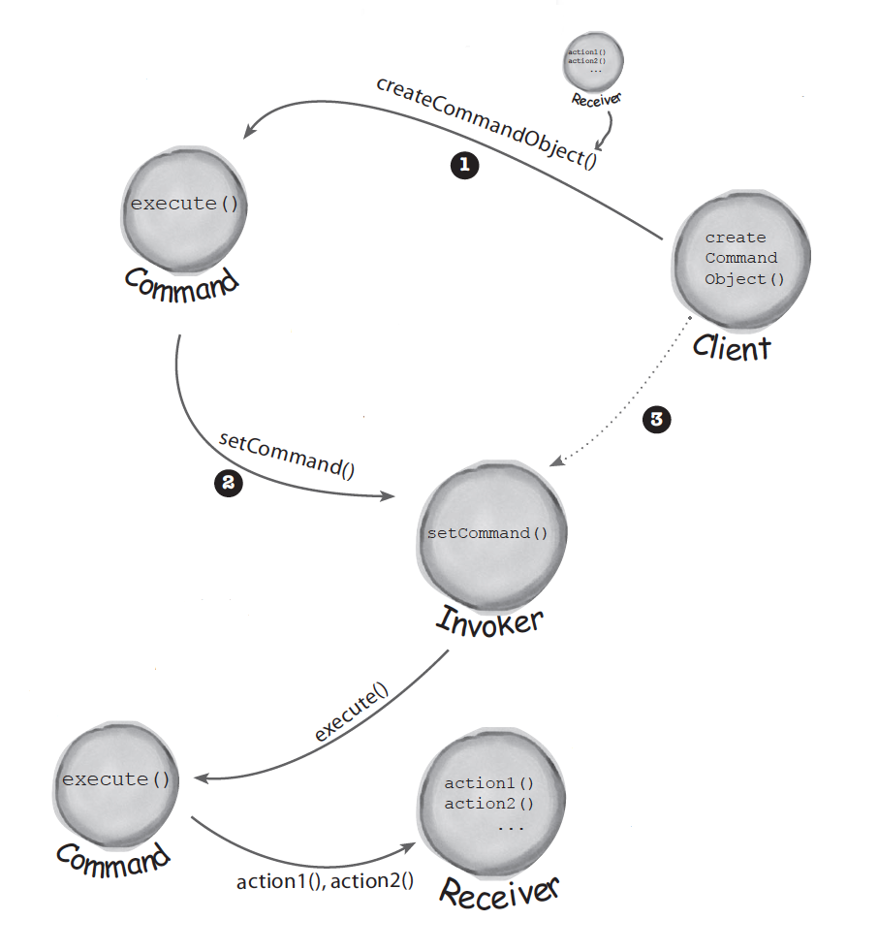
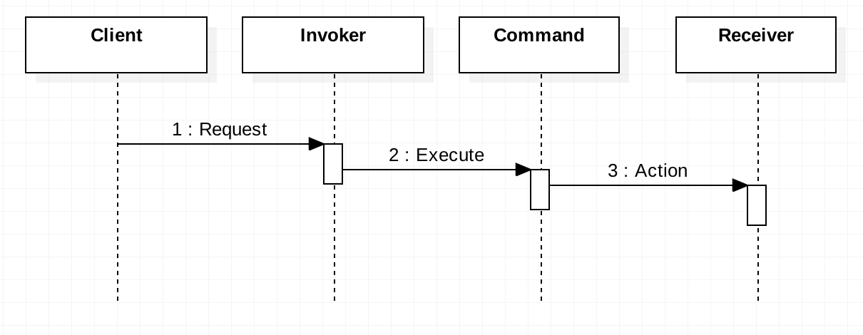
What happen in the example?
TurnTvOn
Loading a invoker:
The client creates a command object .
The client does a set Command( ) to store the command object in the invoker.
Later.. . the client asks the invoker to execute the command. Note: Once the command is loaded into the invoker, it may be used and discarded, or it may remain and be used many times.
DeviceButton
Start Here!!
TurnTVon(command object) → DeviceButton(Invoker)
→ Press (TurnTVon) Button → TV.on(receiver)
TV.on

Slide 5
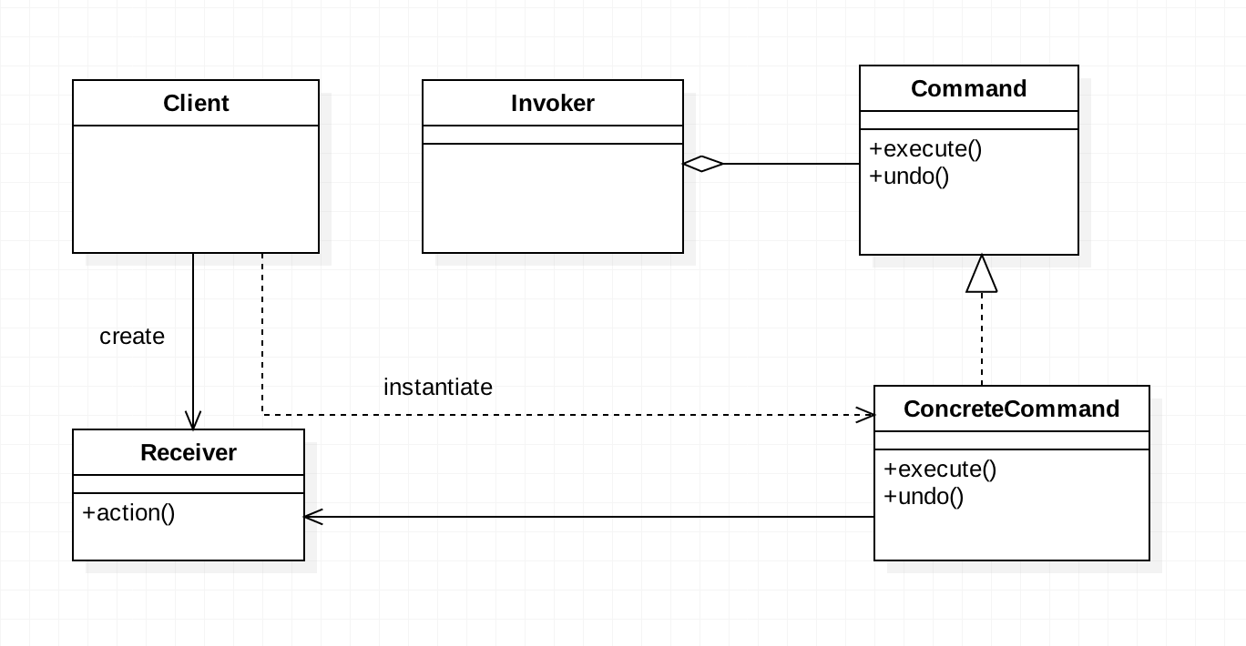
Class Diagram
DeviceButton
This PowerPoint Template has clean and neutral design that can be adapted to any content and meets various market segments. With this many slides you are able to make a complete PowerPoint Presentation that best suit your needs.
This PowerPoint Template has clean and neutral design that can be adapted to any content and meets various market segments. With this many slides you are able to make a complete PowerPoint Presentation that best suit your needs.
This PowerPoint Template has clean and neutral design that can be adapted to any content and meets various market segments. With this many slides you are able to make a complete PowerPoint Presentation that best suit your needs.
3
Put into Queue
execute()/redo()
2
1
TV
TurnTVOn
TurnTVOff
……..
ON
OFF
Notes:
In command pattern, the request is send to the invoker and invoker pass it to the encapsulated command object.
Command object passes the request to the appropriate method of Receiver to perform the specific action.
The client program create the receiver object and then attach it to the Command. Then it creates the invoker object and attach the command object to perform an action.
Now when client program executes the action, it’s processed based on the command and receiver object.

Slide 6
Example
public class Television {
public void on() { System.out.println("TV is on"); }
public void off() { System.out.println("TV is off"); } }
Receiver
Action

Slide 7
Command Interface
public interface Command { public void execute(); public void undo(); }
Concrete Command Interface Implementation
public class TurnTVOn implements Command { Television tv; public TurnTVOn(Television tv){ this.tv = tv; } public void execute() { tv.on(); } public void undo() { tv.off(); } }
public class TurnTVOff implements Command { Television tv; public TurnTVOff(Television tv){ this.tv = tv; } public void execute() { tv.off(); } public void undo() { tv.on(); } }

Slide 8
Invoker
public class RemoteControl { Command command;
Stack<Command> record = new Stack<>();
public RemoteControl (Command command){ this.command = command; }
public void press(){ command.execute(); record.push(command); }
public void pressUndo(){ command.undo(); } }
Record every action for undo in future

Slide 9
Test
public class RemoteControlTest { public static void main(String[] args){ Television tv = new Television();
TurnTVOn onCommand = new TurnTVOn(tv); RemoteControl onPressed = new RemoteControl(onCommand); onPressed.press(); TurnTVOff offCommand = new TurnTVOff(tv); onPressed = new RemoteControl(offCommand); onPressed.press(); Stack<Command> record = onPressed.getRecord(); while (!record.isEmpty()){ record.pop().undo();
} } }
undo actions

Slide 10
Summary
From the outside, no other objects really know what actions get performed on what receiver
Parameterize an object with a command
Use queues and logs and support undo operations.
Command design pattern is easily extendible, we can add new action methods in receivers and create new Command implementations without changing the client code.
The drawback with Command design pattern is that the code gets huge and confusing with high number of action methods and because of so many associations.
Notes:
Command is the core of command design pattern that defines the contract for implementation.
Receiver implementation is separate from command implementation.
Command implementation classes chose the method to invoke on receiver object, for every method in receiver there will be a command implementation. It works as a bridge between receiver and action methods.
Invoker class just forward the request from client to the command object.
Client is responsible to instantiate appropriate command and receiver implementation and then associate them together.
Client is also responsible for instantiating invoker object and associating command object with it and execute the action method.
Command design pattern is easily extendible, we can add new action methods in receivers and create new Command implementations without changing the client code.
The drawback with Command design pattern is that the code gets huge and confusing with high number of action methods and because of so many associations.

Slide 11
Thank you

Slide 12
Reference
Book:
Head First Design Patterns: A Brain-Friendly Guide 1st Edition
Internet Resource:
COMMAND DESIGN PATTERN TUTORIAL Posted by Derek Banas
Link: http://www.newthinktank.com/2012/09/command-design-pattern-tutorial/

